Slide 1
Eukaryotic Genomics

Slide 2
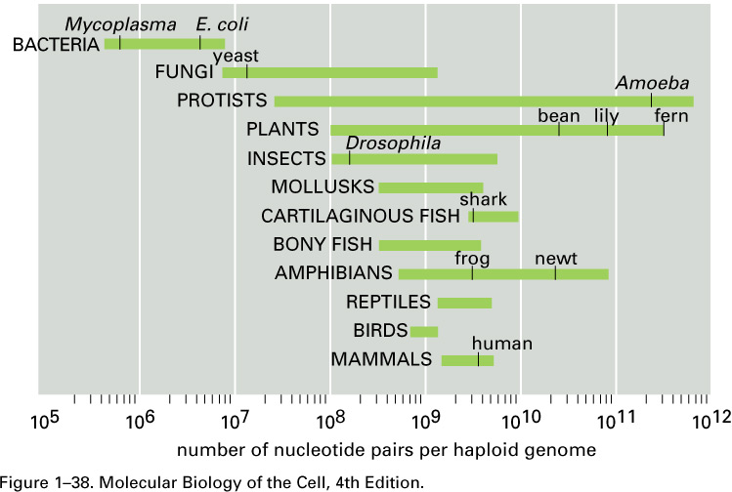
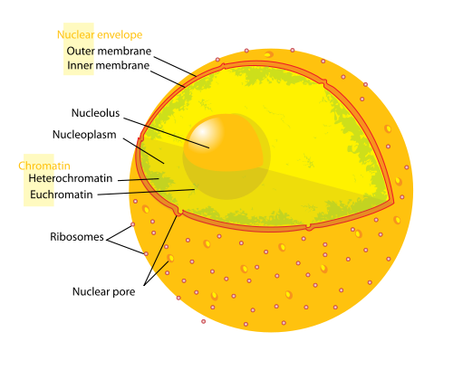
Nuclear Organization
Eukaryotic genomes are orders of magnitudes larger than that of prokaryotes
Different strategies are therefore utilized to package and organize genetic information
Eukaryotic DNA is stored in a specialized cellular organelle called the nucleus.
It consists of multiple linear structures called chromosomes which contain and organize the genetic material
Wikipedia, “Cell Nucleus”, 09/05/2012

Slide 3
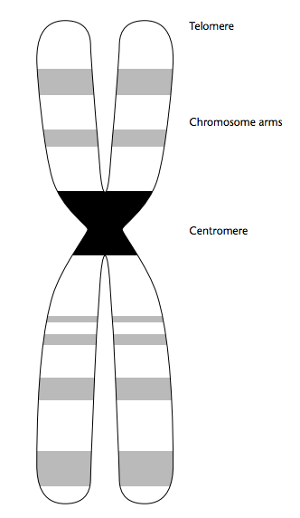
Elements of a Eukaryotic Chromosome
Chromosomes typically consist of two arms; a short arm p, and a long arm q
These arms are connected by a centromere, which consists primarily of a repeated sequence called an α-satellite though other sequences are present as well. Centromeres play an organizational role in chromosome replication
The ends of chromosomes are capped with a region of repetitive sequences called telomeres.
In humans, this sequence is “TTAGGG”.
Telomeres are also involved in chromosome replication where they act as a buffer for replicative mechanisms.
Bickmore (Nov 2001) Eukaryotic Chromsomes. In: eLS John Wiley & Sons Ltd, Chichester.

Slide 4
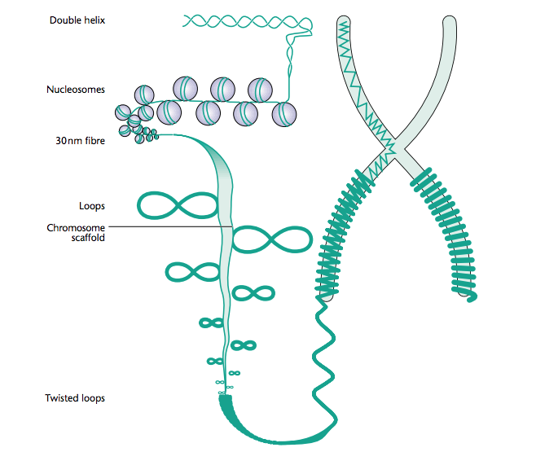
DNA Packaging
Genetic material is packaged using a combination of DNA and proteins called chromatin
These proteins are called histones. A set of four histones form a nucleosome, which serves as “spool” around which DNA is wrapped forming “beads on a string”
Gene-rich regions are found in more loosely packed regions called euchromatin
Other regions are more tightly packed and are termed heterochromatin
(more on epigenomics later in course)
Bickmore (Nov 2001) Eukaryotic Chromsomes. In: eLS John Wiley & Sons Ltd, Chichester.

Slide 5
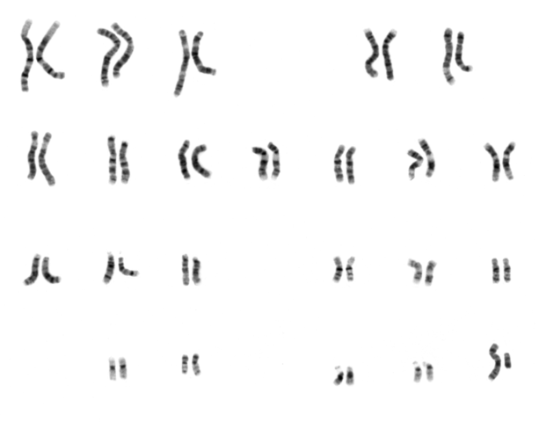
DNA Karyotypes
Humans have 22 pairs of autosomes (chr1-chr22) and two sex chromosomes (X,Y)
Chromosomes range in size from the largest (250 Mbp) to the smallest (46 Mbp), with an average size of around 100Mbp.
Relative size and banding patterns make for individual chromosome identifications. This is an aspect of cytogenetics.
Giemsa banding creates banding patterns with dark areas rich in adenine and thymine (heterochromatic) and light areas with guanine and cytosine (euchromatic)
Wikipedia, “Karyotype”, 09/05/2012

Slide 6
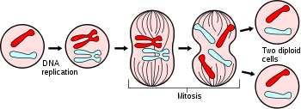
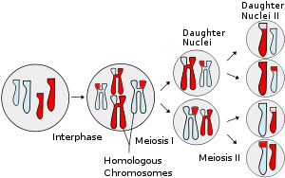
Mitotic and Meiotic Replication
mitosis
Eukaryotic genomes replicate in two different fashions.
Somatic replication occurs during mitosis, whereby genetic material is copied directly into new, diploid (2n) cells
Germline replication occurs during meiosis, whereby genetic material undergoes replication, recombination, and then separation into haploid (1n) gametes.
Recombination
meiosis
Wikipedia, “Mitosis” and “Meiosis”, 09/05/2012

Slide 7
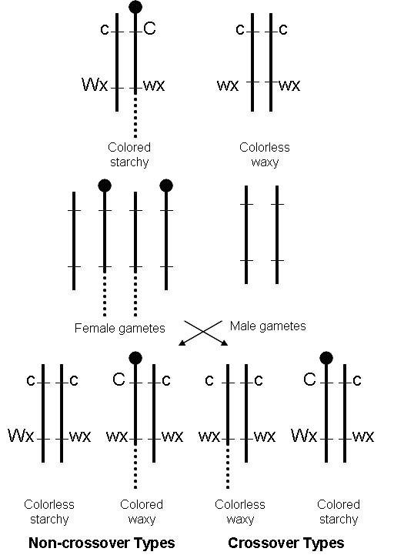
Recombination
Recombination involves the exchange of genetic material, typically between different chromosomes
This process usually occurs between homologous regions, though there are also nonhomologous mechanisms
In eukaryotes, recombination during meiosis allows for a shuffling of genetic material in each gamete
Sharp, L. (1934) Introduction to Cytology (McGraw–Hill, New York), pp. 303, 330, 333.

Slide 8
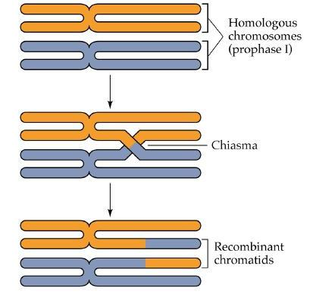
Chromosomal Crossover
Chromosomal crossover is a form of recombination that occurs during meiosis and involves the exchange of material between homologous chromosomes
1-2 crossover events typically occur for each chromosomal pair in each gamete
In most cases, an equal and equivalent amount of DNA is exchanged. However, unequal crossover can result in copy number variants (CNVs) as well as inversions and translocations
Crossover is non-random; over 25,000 small regions of elevated recombination have been characterized as recombination hotspots
Purves et al., Life: The Science of Biology, 4th Edition

Slide 9
Haplotypes
Since recombination is non-random, it is typical for adjacent genomic loci on a chromosome to crossover together during recombination; these are called haplotypes.
Distinct mutations on these haplotypes will therefore be highly correlated with each other. This correlation is referred to as linkage disequilibrium (LD), and it uses a measure referred to as coefficient D.
More about this when we discuss genomic variation in future sessions!

Slide 10
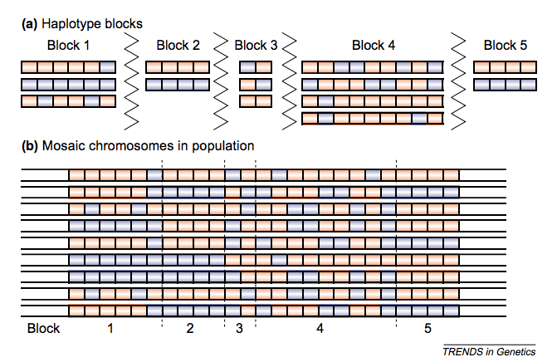
Haplotype Blocks
Cardon, LR and Abecasis GR. (2003) Trends in Genetics, 19(3), pp 135-140

Slide 11
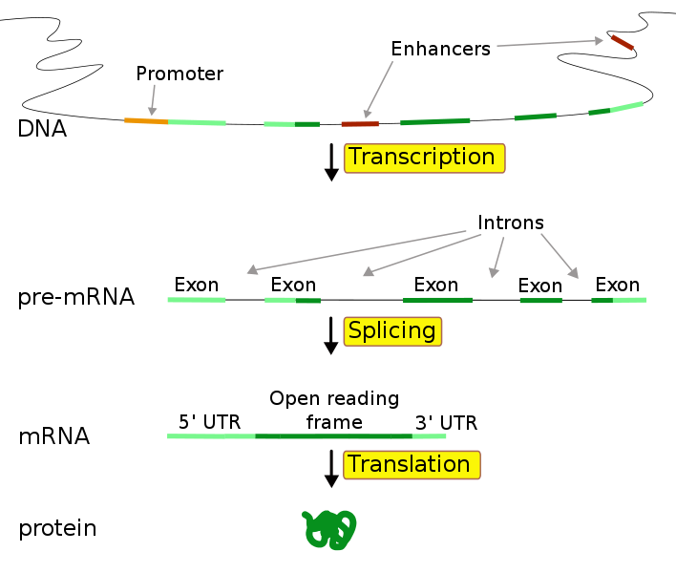
Eukaryotic Gene Structure
Eukaryotic genes usually contain both coding regions termed exons and non-coding regions termed introns. They also contain additional untranslated regions (UTRs) in the 5’ promoter and 3’ terminator regions
Transcription begins at the transcriptional start site (TSS) by RNA polymerase and results in pre-mRNA
Noncoding regions (introns) are then removed through a process termed splicing, forming mRNA
This mRNA is then translated into a protein by ribosomes
Enhancers can regulate this process through transcription factors
Wikipedia, “Gene”, 09/05/2012

Slide 12
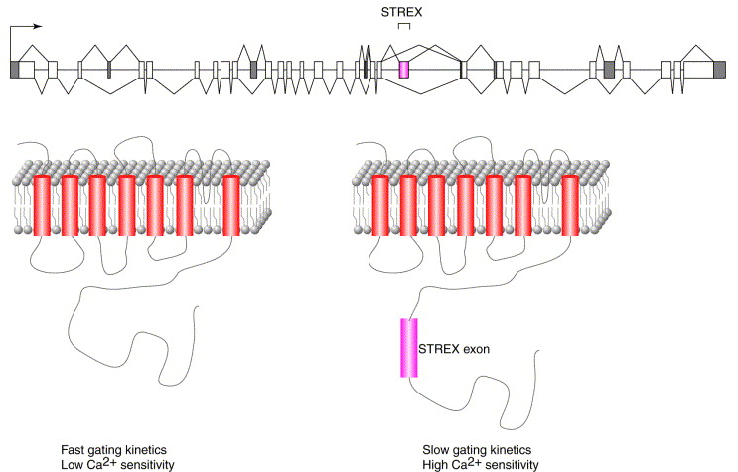
Alternative Splicing
The same gene can be transcribed different ways. These alternative forms are called gene isoforms and typically result in changes to the UTR or protein coding sequences.
Current estimates predict that transcripts from ~95% of the multi-exon genes in humans undergo some form of alternative splicing
Hair cells in the cochlea of the inner ear transfer sound frequencies in part using the calcium-activated potassium channel gene, slo. Alternative splicing of the STREX exon drastically changes the deactivating kinetics of the channel.
Modified from Graveley, B. (2001) Trends in Genetics, 17(20), pp 100-107.

Slide 13
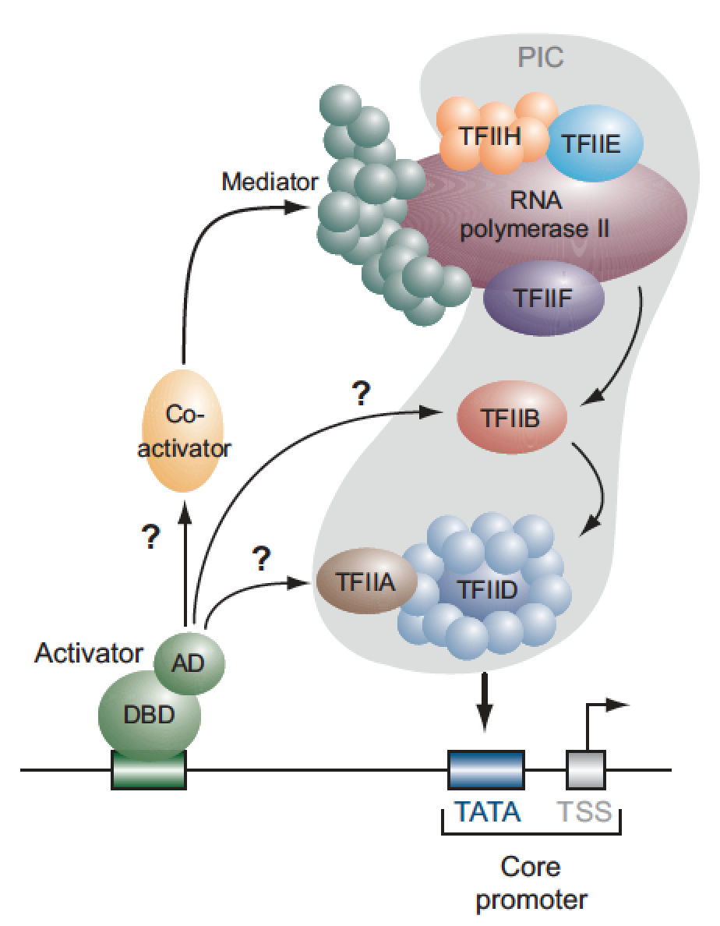
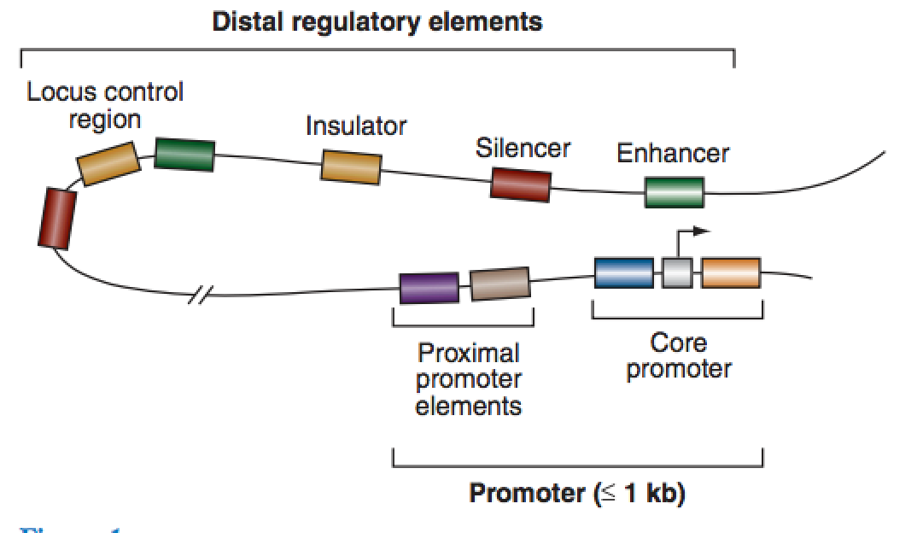
Regulatory Elements
Maston et al. (2006) Annu. Rev. Genomics Hum. Genet. 7, pp. 29-59

Slide 14
Transcription Factors
Transcription factors are proteins that bind to specific DNA sequences to enhance or suppress expression
These typically bind at specific motifs called transcription factor binding sites (TFBS), which can be modeled by a position weight matrix (PWM)
Databases such as TRANSFAC have been developed to store and apply these matrices to new sequence data
Many experimental and computational methods have been developed to predict the location of TFBS
Multiple sequence alignment and motif finding
ChIP-chip, ChIP-seq

Slide 15
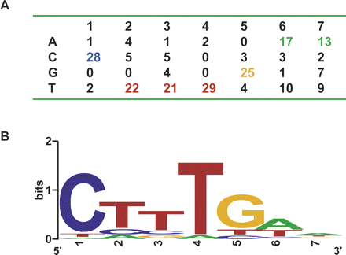
Positional Weight Matrix
Serves as a model for specific positional nucleotide composition
Is often depicted in terms of information content using a sequence logo
(See: Biological Patterns slides for more detail!)
Davies SR et al (2007) Genome Res., 17, pp. 1438-1447

Slide 16
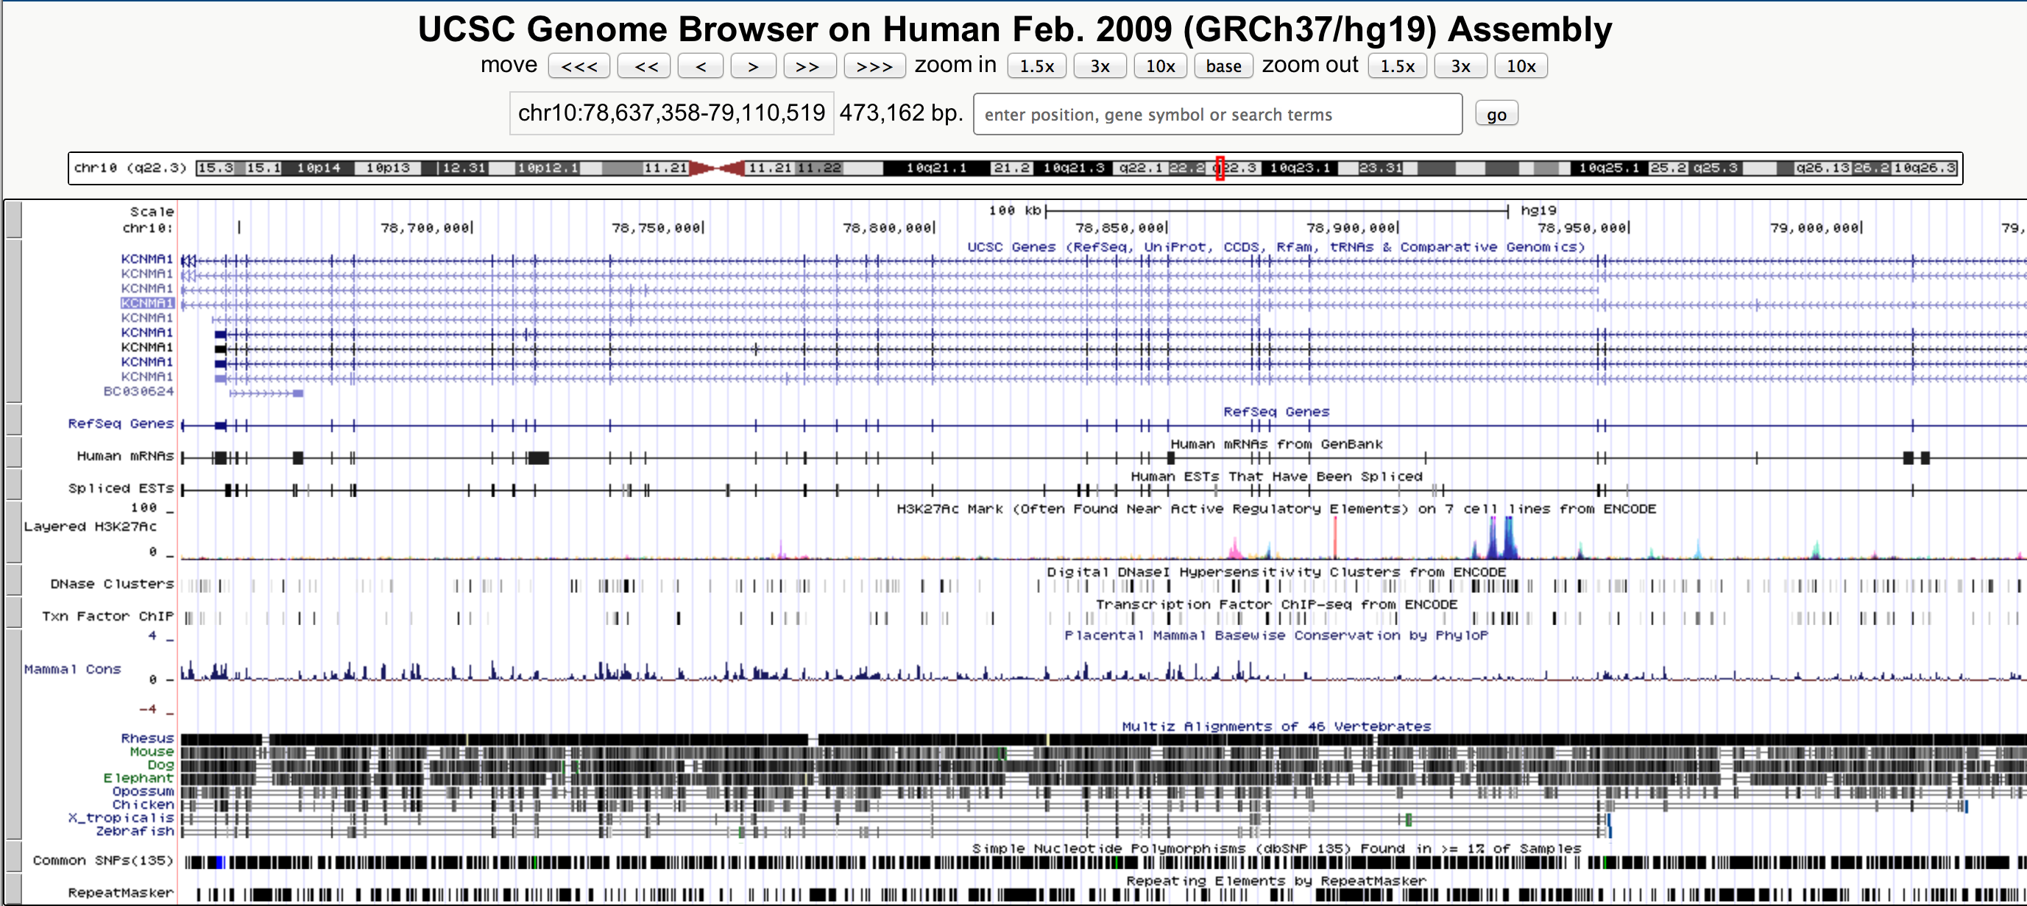
Visualizing Genes & Genomes
UCSC Genome Browser (http://genome.ucsc.edu/)

Slide 17
Reference Genomes
First human draft genomes released in 2001 and “completed” in 2003
Consisted of public (HGP) and private (Celera) genome assemblies
Numerous updates in the past decade
Varying nomenclature and versions
hg17/hg18/hg19 via UCSC Genome Browser
NCBI36/NCBI37 via NCBI
GRCh37/GRCh38 via Genome Reference Consortium
Chromosomal sequence is typically consistent between equivalent versions (e.g. GRCH37/hg19), however differences in headers, masking and naming may cause issues with software if interchanged. There are also differences in which mitochondrial DNA (chrM) is currently used.
There are now reference sequences available for many eukaryotes, including 26 mammals, 12 vertebrates, and 6 nematodes

Slide 18
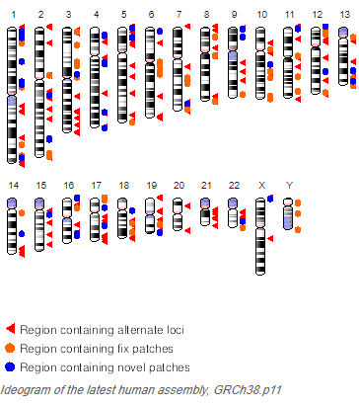
Reference Patches
Genome reference updates are currently done by the Genome Reference Consortium (GRC)
Patches allow the GRC to update specific loci without disrupting current coordinates
Consists of “fix” patches, which improve and update the existing tiling path, and “novel” patches, which are the eventual inclusion of new alternative loci
https://www.ncbi.nlm.nih.gov/grc/human

